Slide 1
Problem Fomulation

Slide 2
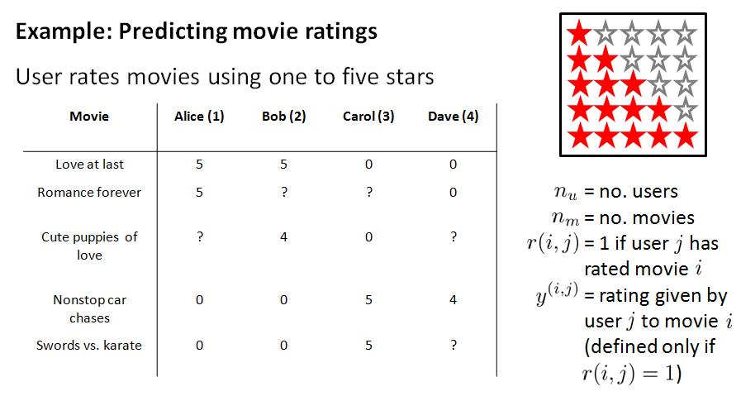

Slide 3
Collaborative filtering algorithm

Slide 4
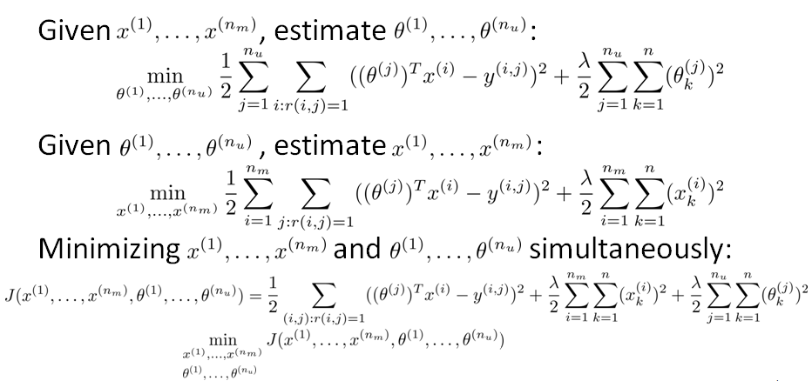
Collaborative Filtering Optimization Objective

Slide 5
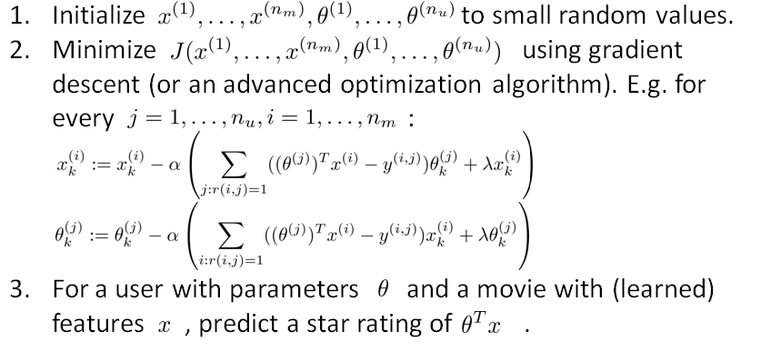
Collaborative Filtering Algorithm

